Slide 1

Manchester Raspberry Jam 34
December 2015

Slide 2
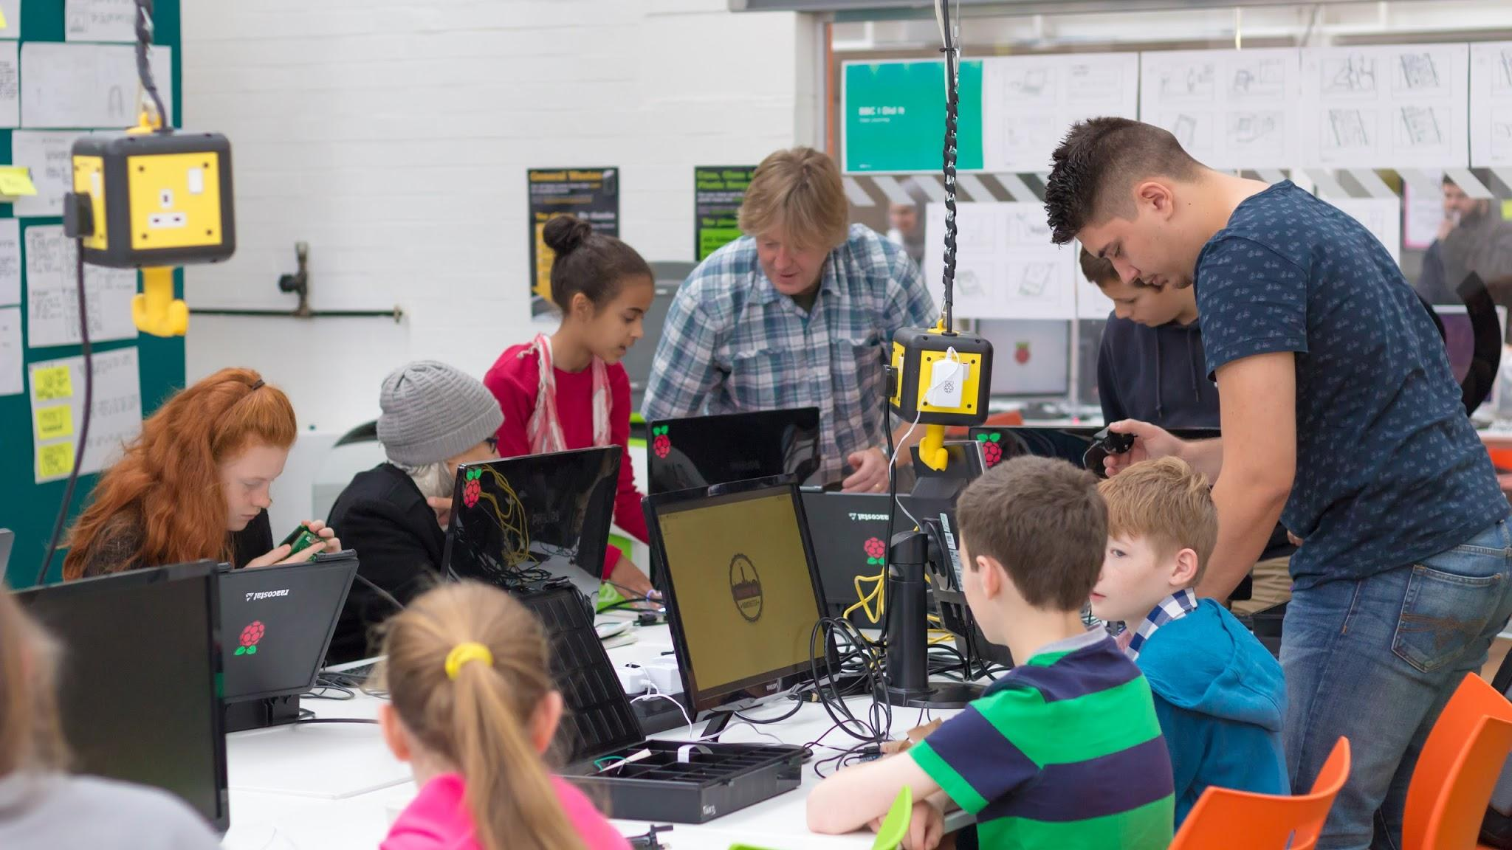
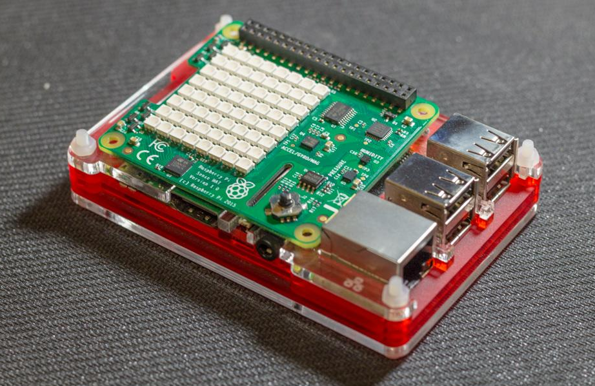
Last Time:

Slide 3
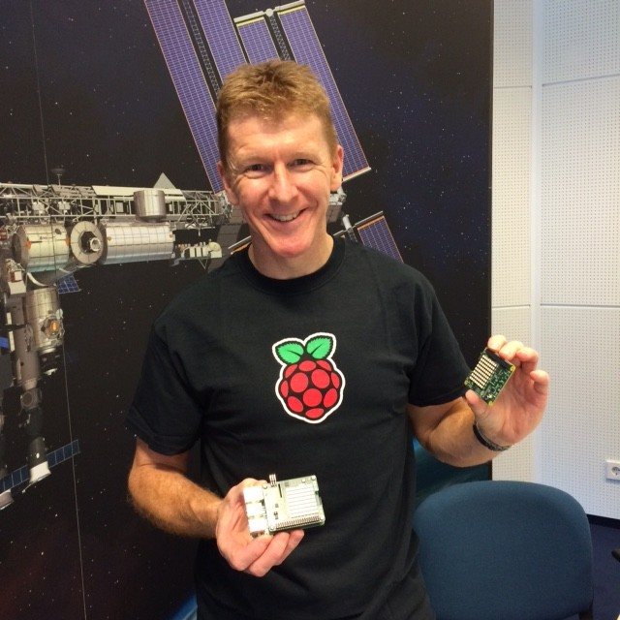
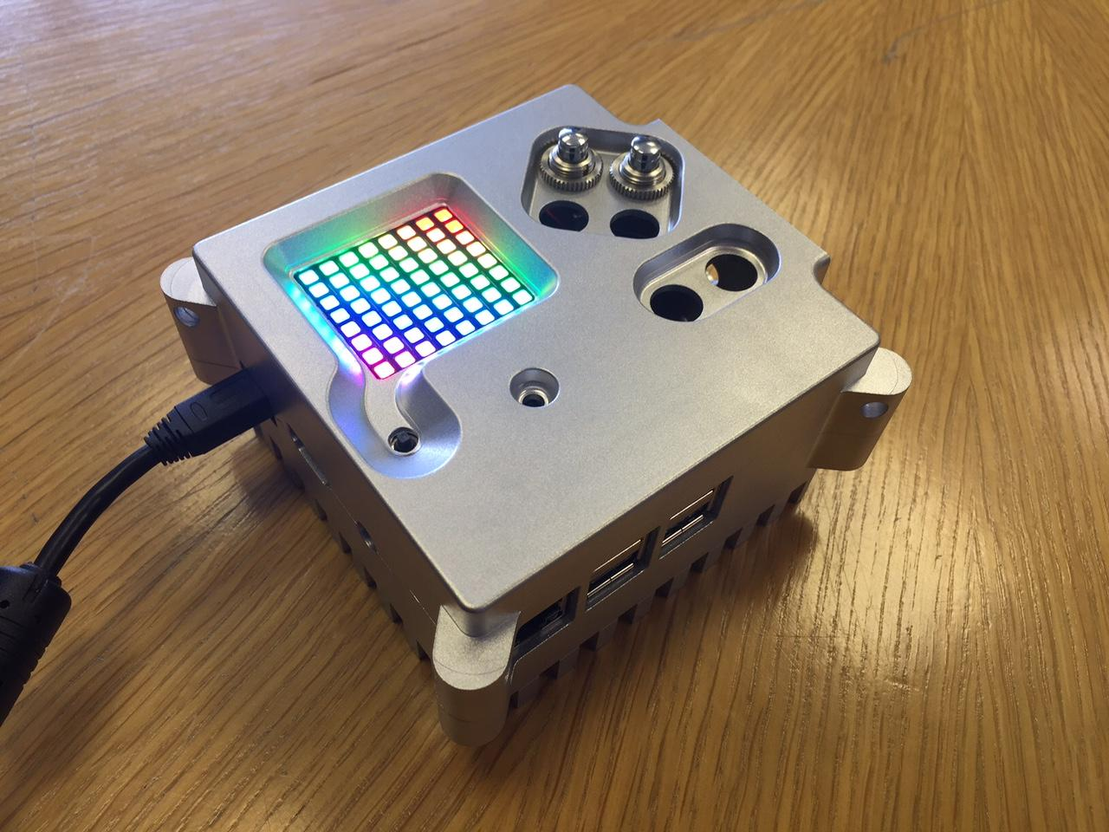
Last Time:

Slide 4
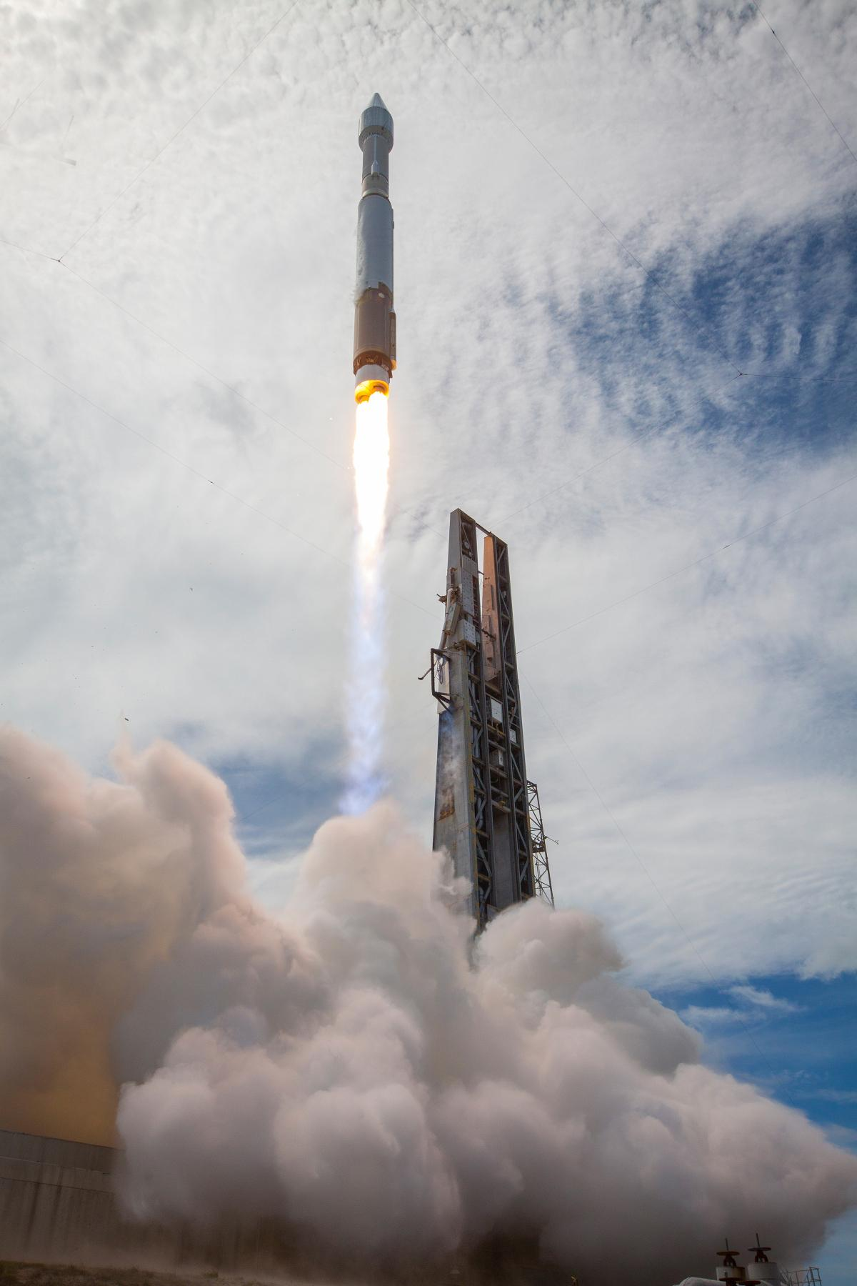
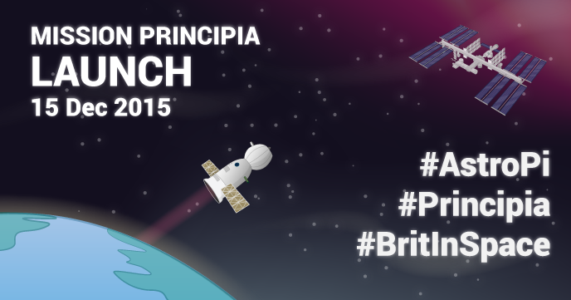

Slide 5
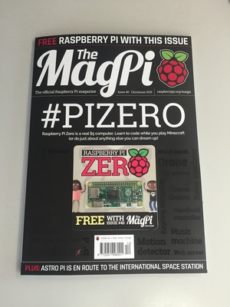
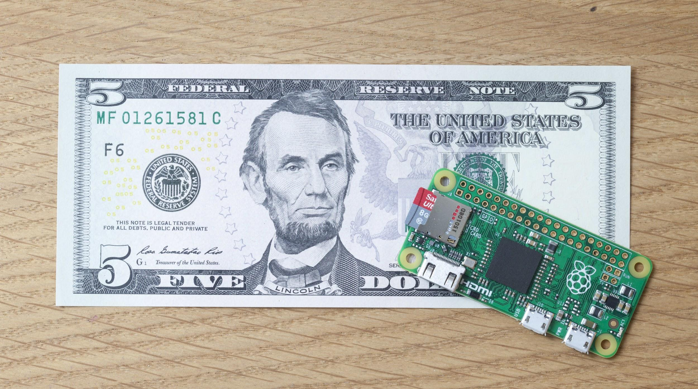
In the news:

Slide 6
Workshops
Morning:
Codebug Workshop
Christmas Decorations
Afternoon: Animation
Create a design in Minecraft
Animate on the Sense HAT

Slide 7
Today:
11:00 - Codebug Workshop
13:00 - Lunch
14:00 - Sense HAT animation workshop
15:00 - Christmas Raffle
WiFi:
SSID MMU-Visitor
Pass. University
Next Jam:
Saturday 13th February mcrraspjam35.eventbrite.co.uk
Share photos with #McrRaspJam
Slides and other downloads at: bit.ly/McrRaspJam

